Slide 1
Euro Health Consumer Index 2014
Brussels, January 27, 2015
Arne Björnberg, PhD
Johan Hjertqvist, LLH
info@healthpowerhouse.com

Slide 2
“Health System Performance Assessment: reconciling the measurable with the meaningful”
Dr. Vytenis Andriukaitis,
EU Health commissioner

Slide 3
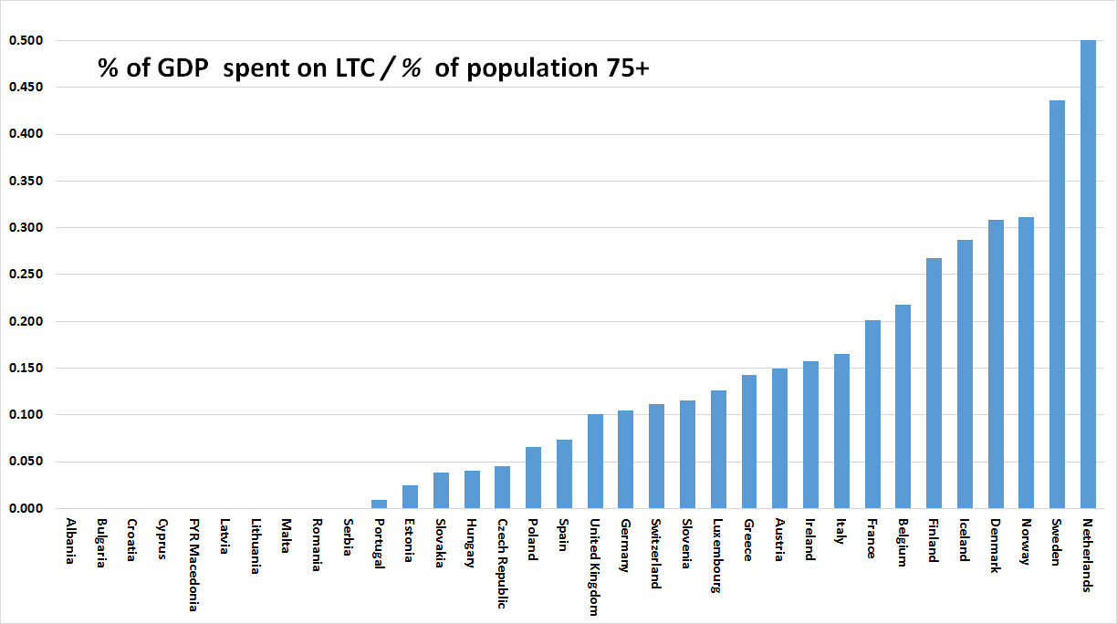
The aging challenge
A gigantic problem, or a fantastic sign of success
for modern healthcare?

Slide 4

About
Health Consumer Powerhouse
Comparing healthcare systems performance in 35 countries from a consumer/patient view.
Since 2004, more than 40 index editions, available for free.
Index projects financed through unconditional development grants, similar to medical faculty sponsored research.
Europe
Euro Health Consumer Index 2005, 2006, 2007, 2008, 2009, 2012, 2013
Euro Consumer Heart Index 2008
Euro Diabetes Care Index 2008, 2014
Euro HIV Index 2009
Euro Patient Empowerment Index 2009
Nordic COPD Index 2010
Tobacco Harm Prevention Index 2011
Euro Headache Index 2011
Euro Hepatitis Index 2012
Euro Vision Scorecard 2013
Euro Pancreatic Cancer Index 2014
Sweden, others
Health Consumer Index Sweden 2004, 2005, 2006
Diabetes Care Index Sweden 2006, 2007, 2008
Breast Cancer Index Sweden 2006
Vaccination Index Sweden 2007, 2008
Renal Care Index Sweden 2007, 2008
Smoke Cessation Index Sweden 2008
COPD Index Sweden 2009, Nordic 2010
Advanced Home Care Index Sweden 2010
Euro-Canada Health Consumer Index Canada 2008, 2009
Provincial Health Consumer Index Canada 2008, 2009, 2010
All Hospitals Index Sweden 2011

Slide 5
EHCI 2014
Important trends
Treatment results in European healthcare keep improving essentially everywhere!
Wealthy countries do better in the EHCI – the “equity gap” more obvious than in previous years
Savings on pharmaceuticals the most obvious effect of austerity
Some patterns remarkably stable over time – waiting lists a mental condition?
“Big Beveridge” have problems delivering!

Slide 6
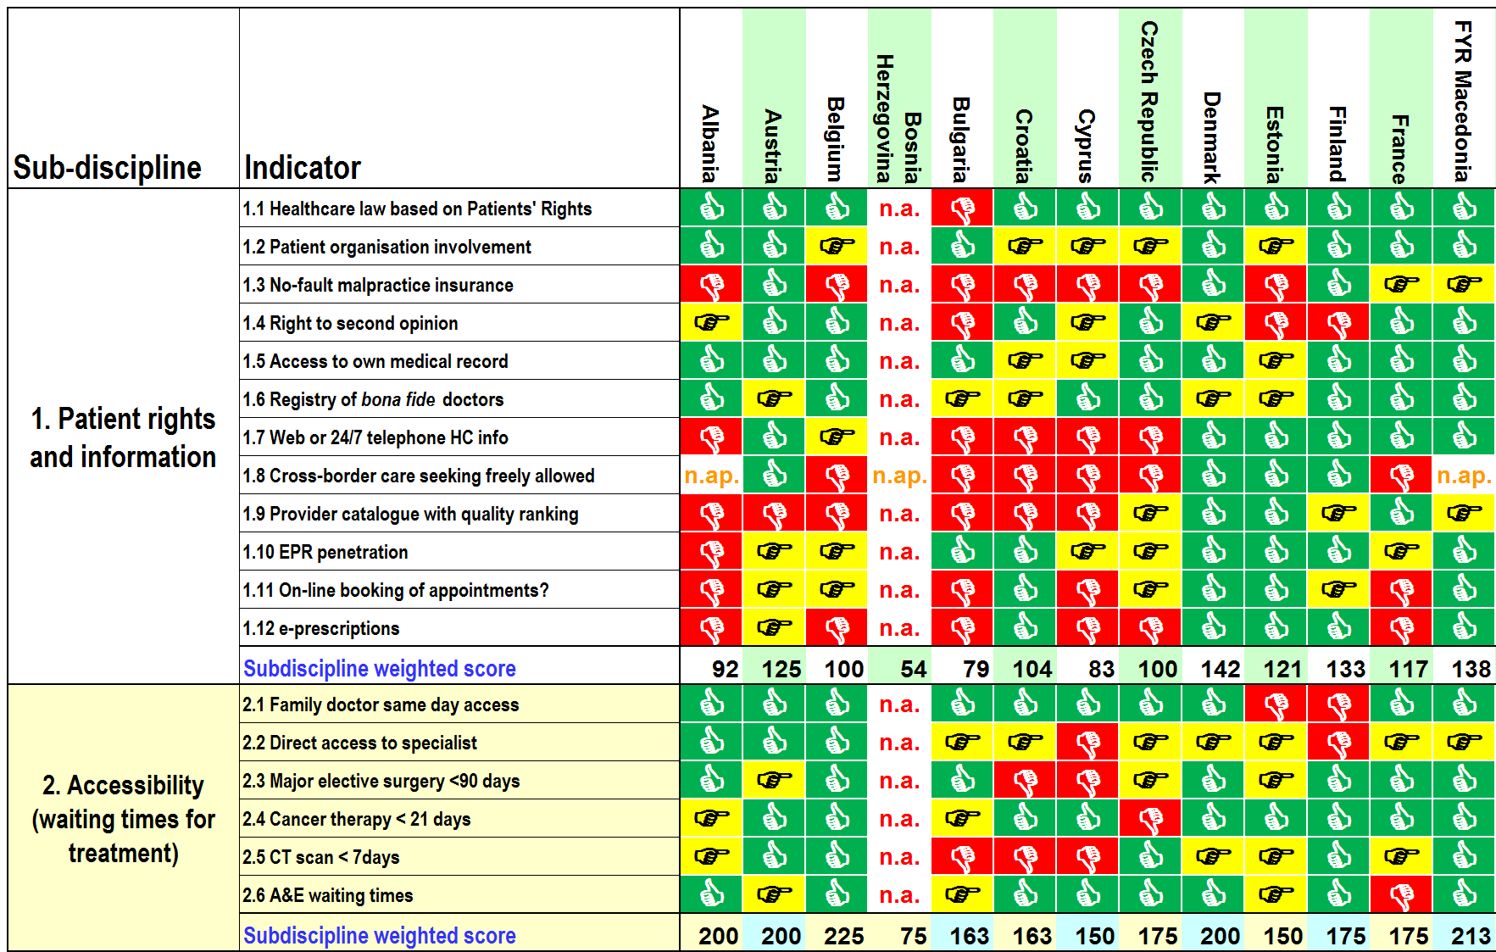

Slide 7
EHCI 2014 sub-disciplines
Sub-discipline | Weight (points out of 1000 for full score) | Doing well
Patient rights, information and e-Health | 150 | Netherlands, Denmark, Norway, FYR Macedonia, Iceland
Waiting times / Access | 225 | Belgium, Switzerland, FYR Macedonia
Outcomes | 250 | Netherlands, Norway, Iceland, Switzerland, Germany
Range & Reach of services provided | 150 | Netherlands, Sweden, Norway, Belgium, Finland
Prevention | 125 | Iceland, Norway, Spain, Sweden
Pharmaceuticals deployment | 100 | Finland, Germany, Ireland, Netherlands, UK
A total of 48 indicators in six sub-disciplines
And we have really tried to be inventive and make the Index more challenging, but there is no stopping The Netherlands!

Slide 8
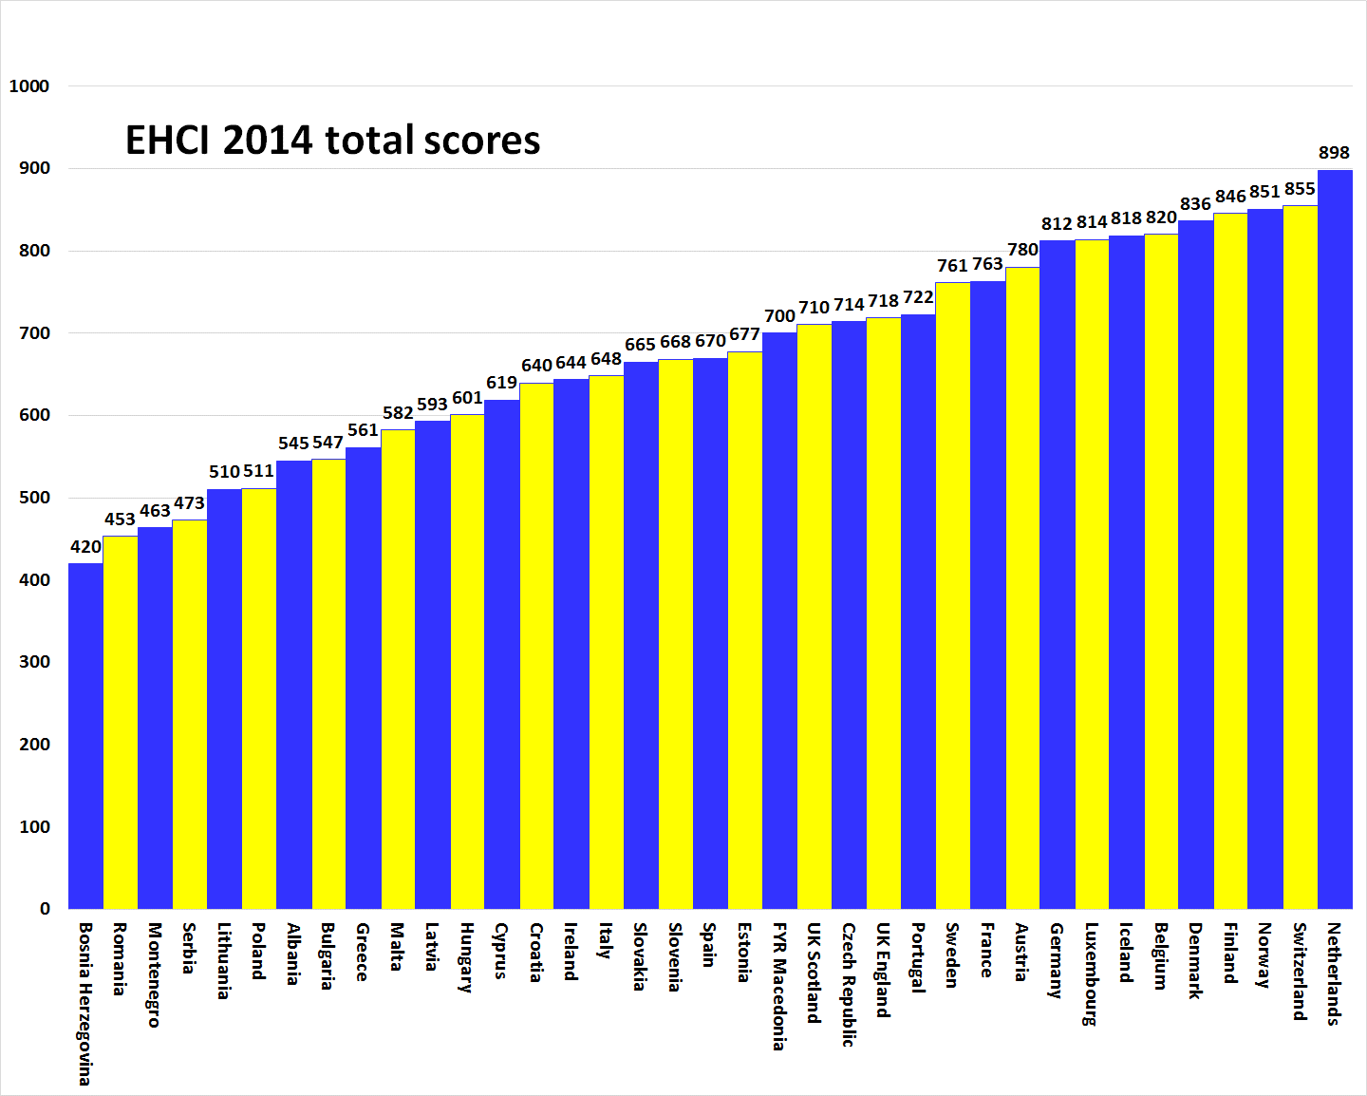

Slide 9
What can Europe learn from
The Netherlands?
”Chaos” systems, where patients can choose where to seek care, do better than ”planned” systems;
  but ”chaos” needs to be managed, and the NL does that very well!
Choice and competition! (and remember that this has to have a ”grandfather” function managing the system!)

Slide 10
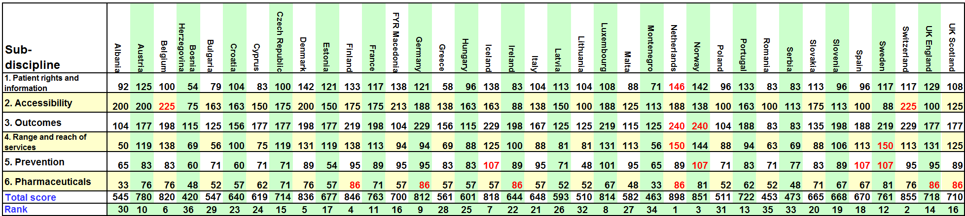
So what could be the improvement potential for the European Champions?
The Netherlands top 4 sub-disciplines; some potential
for improvement on Accessibility, but no country ever
did that before!

Slide 11
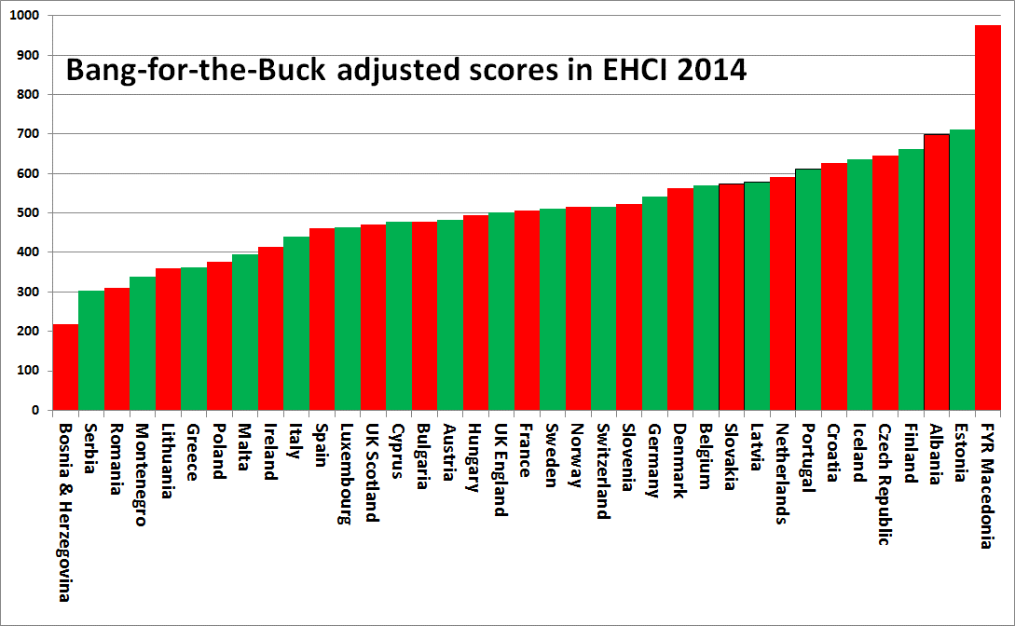
Estonia, Finland, Czech Republic, Iceland, Croatia
seem to give good value for money in healthcare!

Slide 12
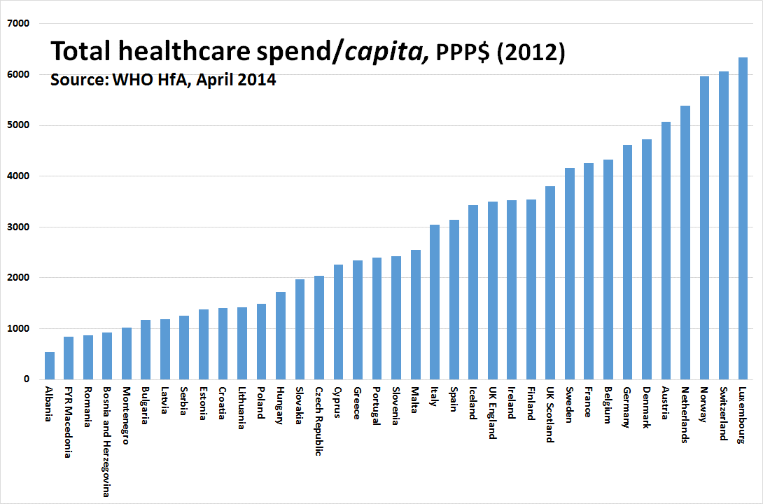
GP gatekeeping does not contain costs!

Slide 13
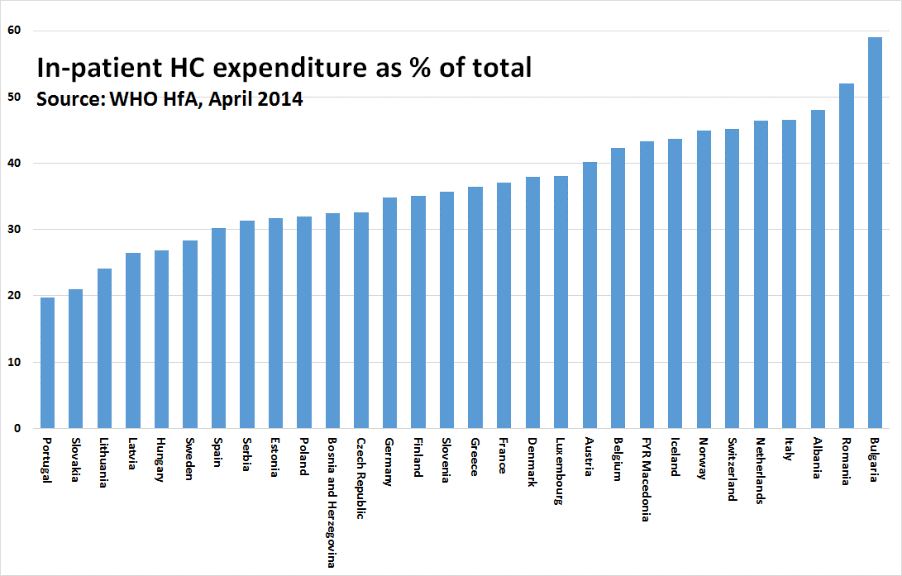
”Structural Antiquity” Index for healthcare systems

Slide 14
Savings potential if Dutch healthcare would approach the in/out-patient mix of Sweden
EUR 8 billion/year?
i.e.; the high Dutch costs are more due to how healthcare is operated – not due to a payment or administrative ”model”

Slide 15
Accessibility of European healthcare
Europe is divided into
”waiting list territory” (Red) and ”non-waiting list territory” (Green).
This is independent of GDP/capita.
Has improved since 2013!
Accessibility from EHCI 2014

Slide 16
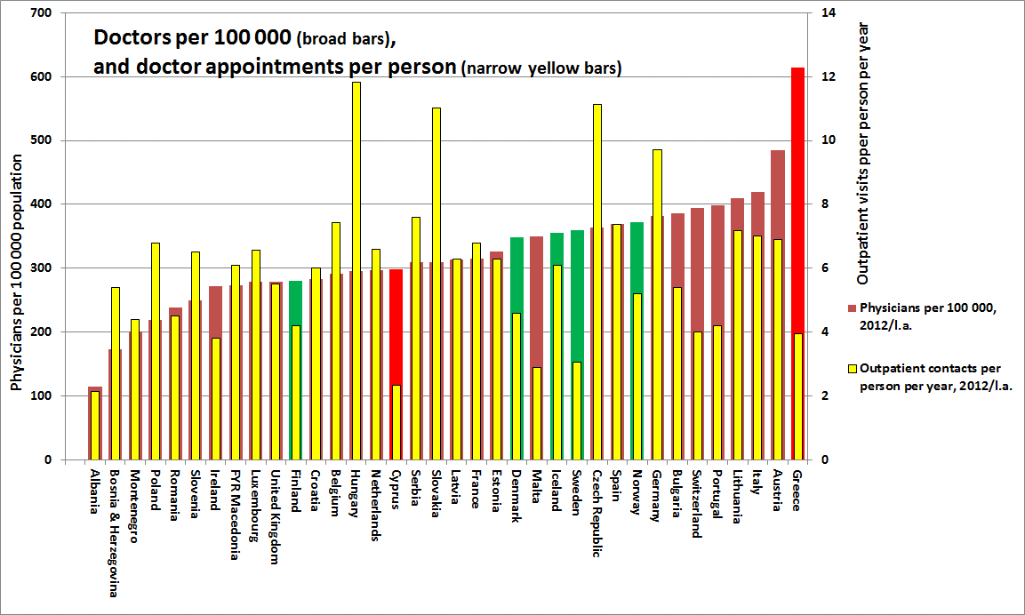
Accessibility not really related to number of doctors!

Slide 17
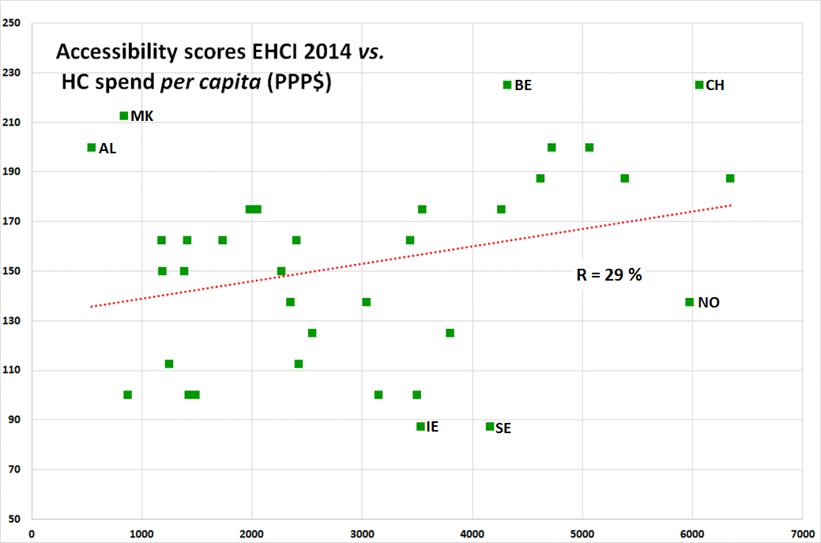
Money does not necessarily buy better
access to healthcare!

Slide 18
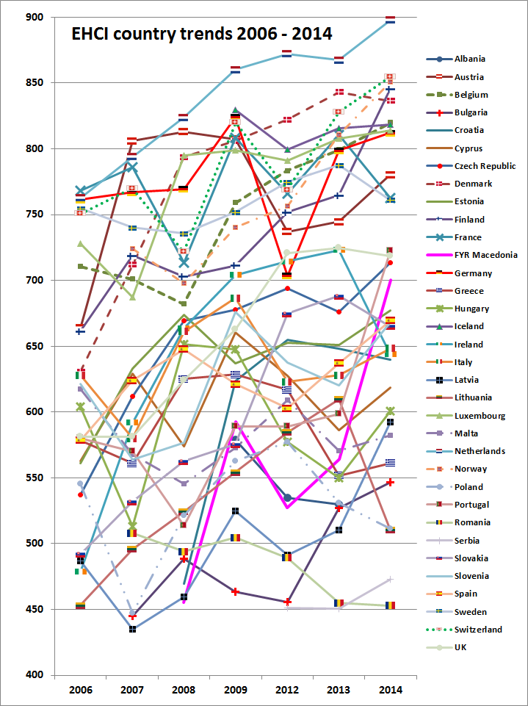
If you spend enough time looking at this graph, you will discover that particularly countries in the top keep improving.
Inequity seems to be increasing in Europe after the financial crisis!

Slide 19
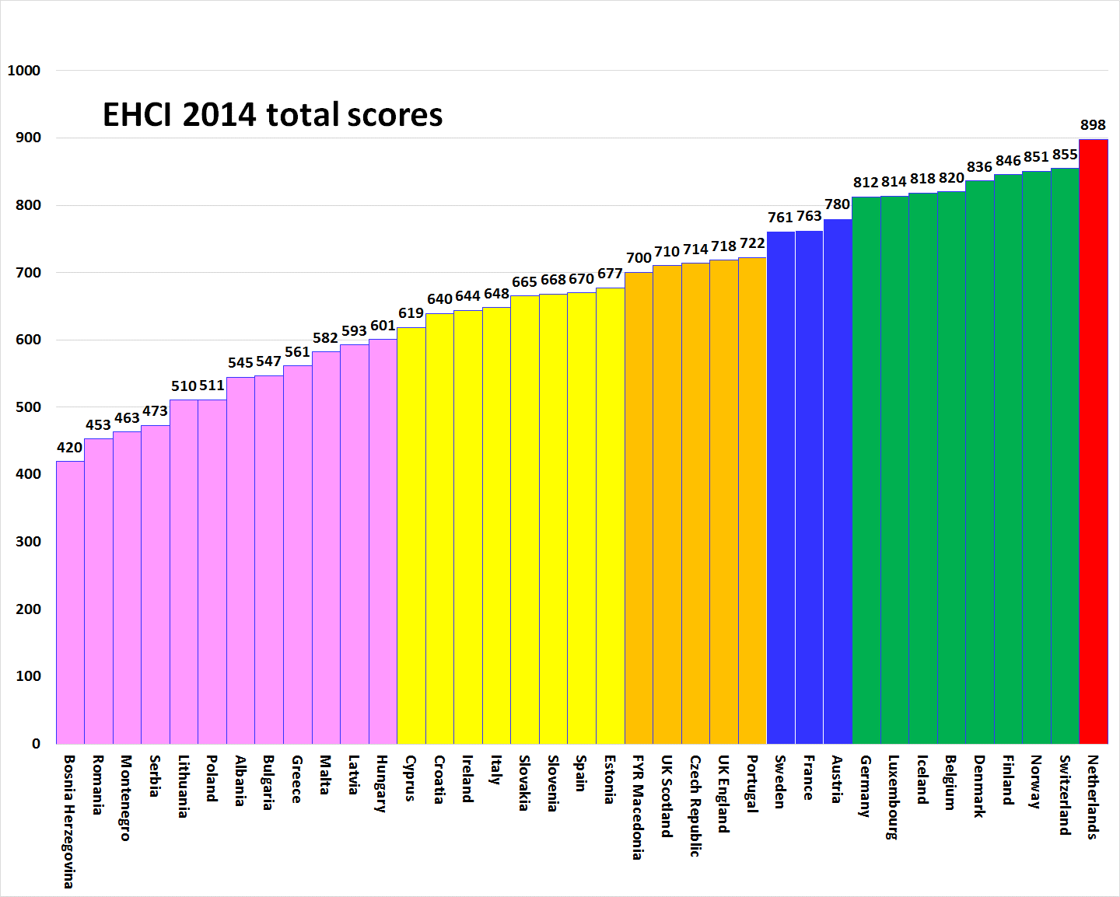
More obvious wealth-related clusters

Slide 20
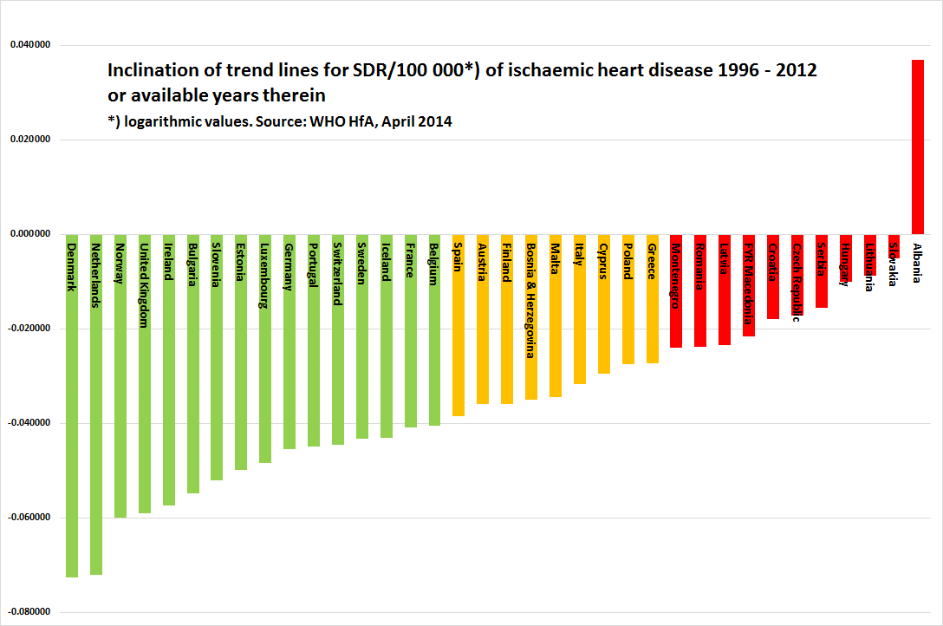
Treatment results keep improving!

Slide 21
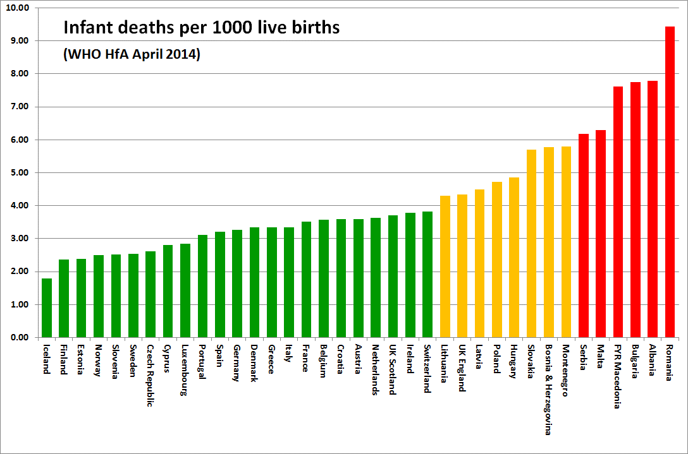
Treatment results keep improving!
In EHCI 2006, there were 9 Green scores,
using the same cut-offs

Slide 22
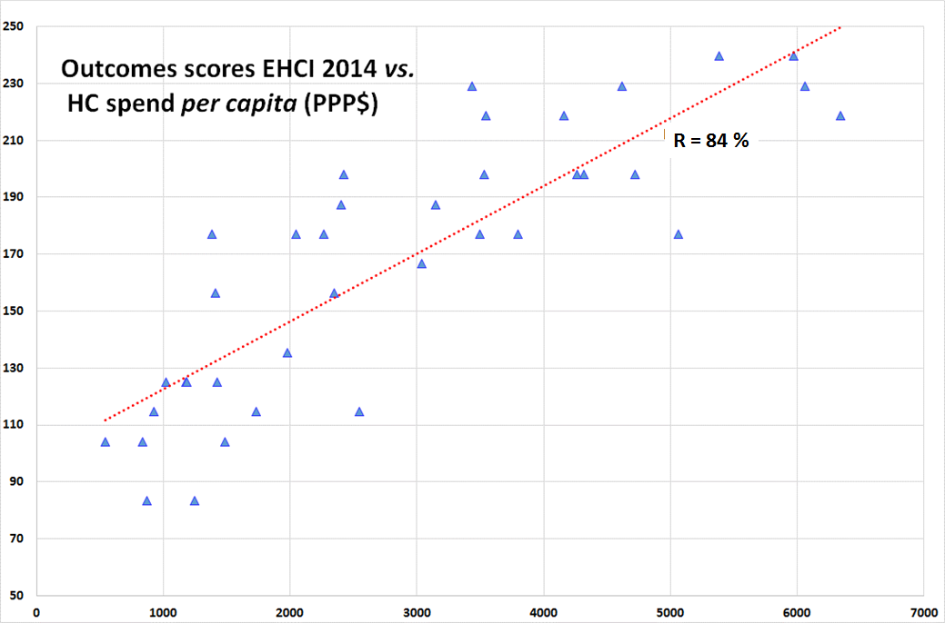
Money does buy better Treatment Results

Slide 23
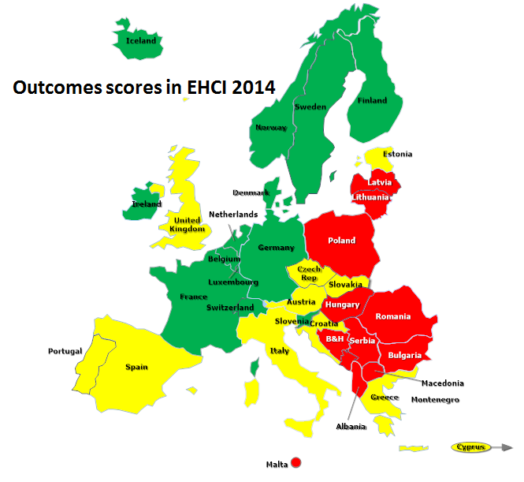
And yes; wealthy countries have better Outcomes – but not all!
”Big Beveridge”
(ES, IT, UK) not quite
making it!

Slide 24
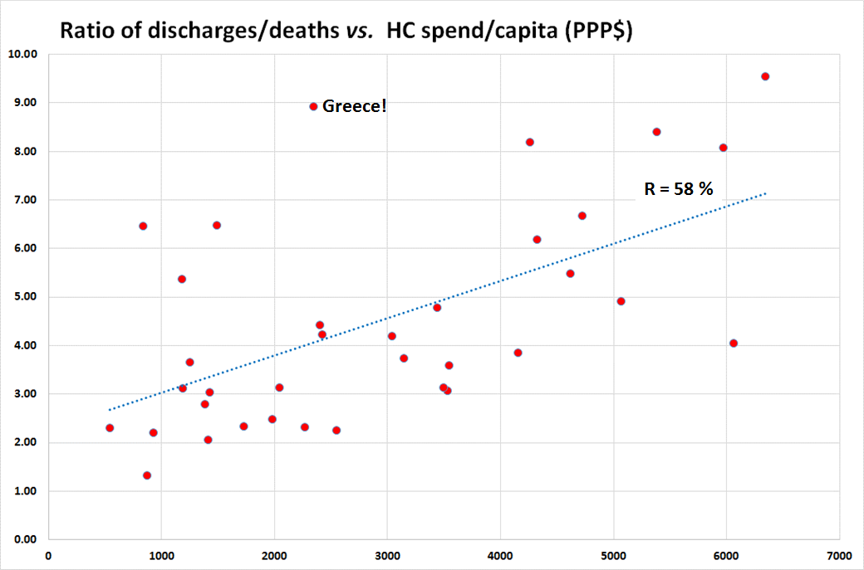
An example of a LAP Indicator; ”Level of Attention to the Problem”.
Wealthy countries can afford admitting patients on weaker indications,
but there are deviations!
Greek hospitals have press gangs
roaming city streets?

Slide 25
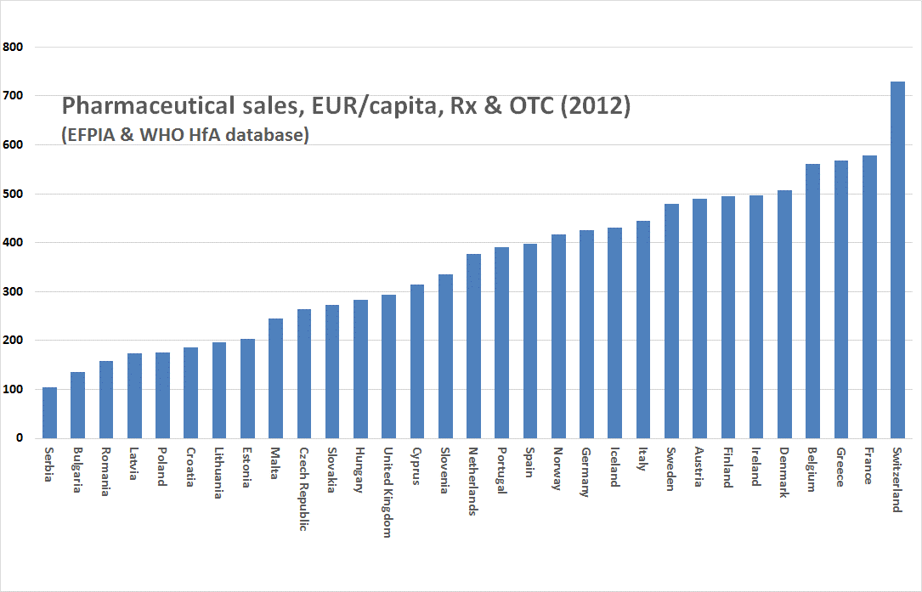
Greeks can somehow carry on spending on drugs and hospital admissions
There is no evidence which supports that public health benefits from dispensing drugs to deceased patients

Slide 26
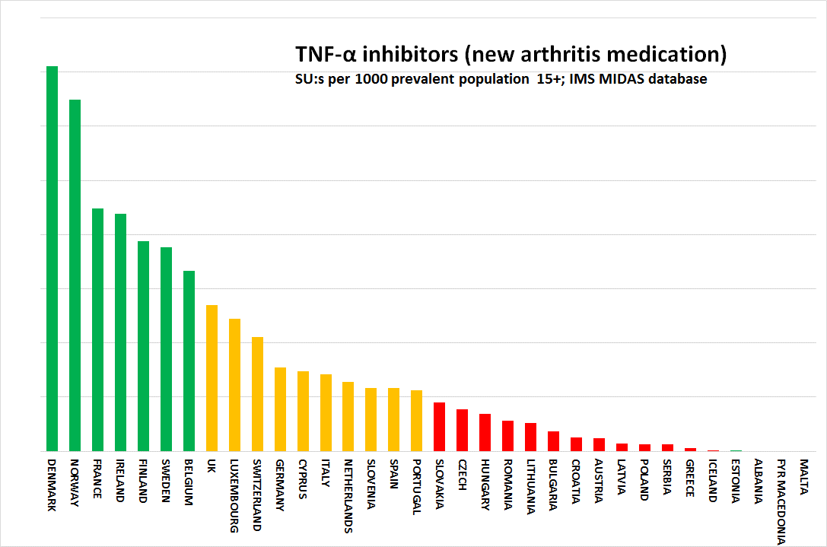
Restrictivity with new drugs

Slide 27
England and Scotland have separate National Health Services!!!
Scotland has 10 % higher healthcare spend per capita
Could be fair; the public health situation is more troublesome in Scotland
But the two systems are basically the same, when measured on a scale intended for 36 European countries!
Scotland 710 – England 718!
Scotland sadly not providing the open hospital results data of NHS Choices
There is scant evidence for having separate sets of administrators making a difference at all for anything!

Slide 28
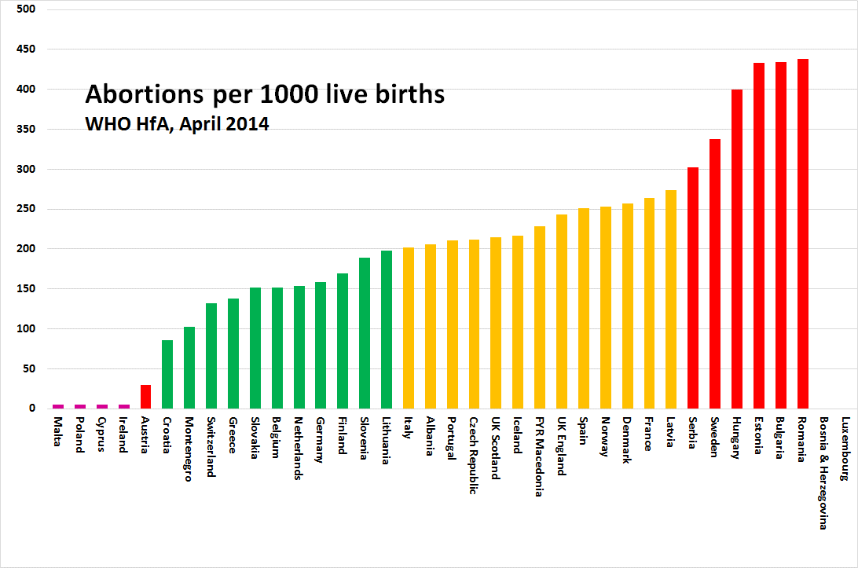
Women should have the right to abortion, but abortion as a contraceptive is not a good idea!
CEE abortion rates on their way down?

Slide 29
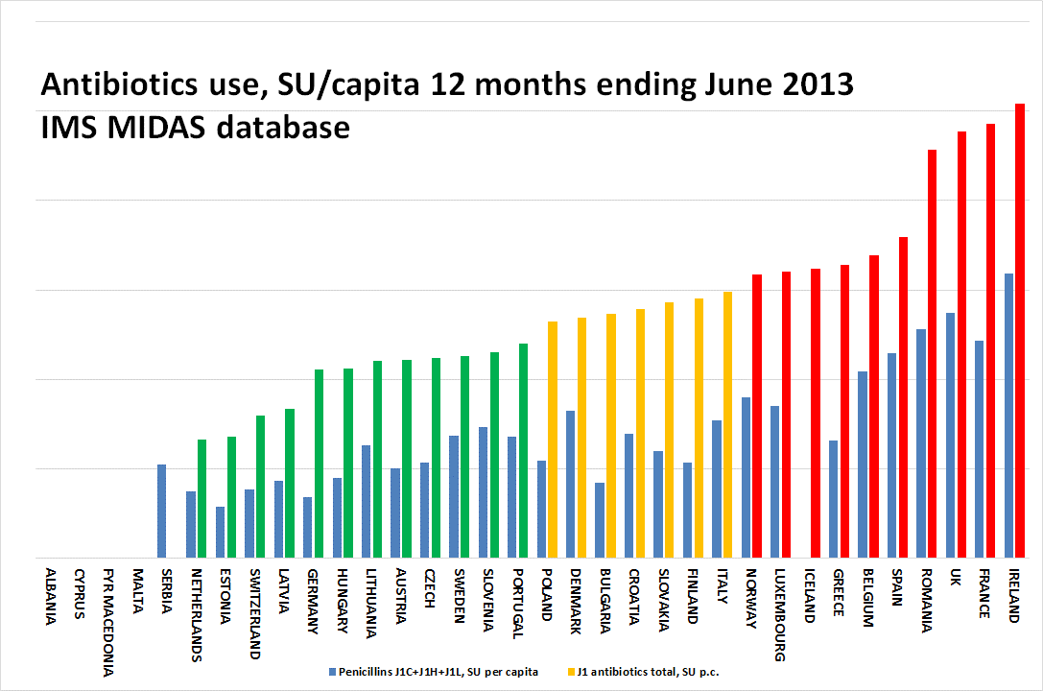
The 2013 indicator on use of antibiotics

Slide 30
The 2014 indicator on use of antibiotics – who do we trust?

Slide 31
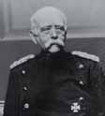
”Bismarck Beats Beveridge”
Bismarck systems dominate the top of EHCI ranking
  Beveridge systems offer conflicts between loyalty to citizens and loyalty to healthcare system/organisation (“politician home town job preservation”)
  lack of business acumen in Beveridge systems; efficiency gains and cutbacks frequently not differentiated!
  small Beveridge systems (the Nordic countries) can compete
“Chaos” systems do better than centrally planned
  100’s of thousands of professionals take better decisions and drive development better than central bodies
  incentives driving quality and productivity are essential!

Slide 32
MORE SLIDES

Slide 33
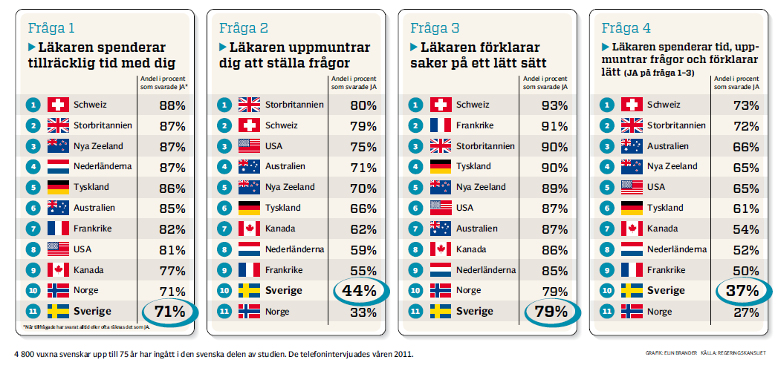
”The verdict of the people on the medical profession.
Swedes are less satisfied with attitudes and communication skills of doctors, says international comparison. Norway and Sweden bottom of 11 countries compared.” (Dagens Medicin 2012-02-29)
The cherished notion that ”In Sweden, we provide holistic medicine – in contrast to ’assembly line medicine’ down on the Continent ” lacks evidence!.

Slide 34
Websites with comprehensive information about all registered pharmaceuticals 2013 (OTC and Rx)
Austria: www.austriacodex.at/avmain/ http://pharmaweb.ages.at/index.jsf
Belgium: http://www.bcfi.be/, www.pharma.be
Croatia: http://www.almp.hr/?ln=hr&w=lijekovi
Czech Republic: www.zdravotnickenoviny.cz/scripts/modules/catalogue/search.php?catalogueID=2
Denmark: http://medicin.dk/
Estonia: www.raviminfo.ee
Finland: www.fimea.fi/lakemedel/produktresumeer/humpl
France: www.doctissimo.fr
Germany: www.onmeda.de
Greece: www.galinos.gr/web/drugs/main/lists
Hungary: www.ogyi.hu/drug_database/
Ireland: www.medicines.ie
Italy: www.prontuariofarmaci.com
Latvia: http://www.zva.gov.lv/index.php?id=375&sa=375&top=334
Lithuania: www.vaistai.lt
Malta: http://medicinesauthority.gov.mt/products/search.htm
Netherlands: www.cbg-meb.nl/CBG/en/human-medicines/geneesmiddeleninformatiebank/default.htm
Norway: www.legemiddelverket.no/custom/Preparatsok/prepSearch____80333.aspx?filterBy=CopyToConsumer
Portugal: www.infarmed.pt/infomed/inicio.php
Romania: www.anm.ro/en/html/pharmacopoeia.html
Slovakia: www.liekinfo.sk
Slovenia: www.zdravila.net
Sweden: www.fass.se
Switzerland: www.kompendium.ch
U.K.: http://emc.medicines.org.uk/

Slide 35
Why do we not see clearer traces of the financial crisis?
Healthcare traditionally weak at measuring output/outcomes.
“The good old days that never were”
Underlying improvement forces are very strong!

Slide 36
THANK YOU -
SEE IT ALL ON www.healthpowerhouse.com

Slide 37
"What is the secret behind the rapid improvement of Macedonian healthcare performance?“
Nicola Todorov
Minister of Health,
Republic of Macedonia

